Slide 1
Recent highlights on level of alcohol abuse and Key research gaps for Uganda
Nazarius Mbona Tumwesigye
Cissie Namanda
Claire Biribawa

Slide 2
Outline
Introduction
Recent highlights of level and effects of alcohol abuse
Key research gaps with policy perspective
conclusion

Slide 3
Introduction
While the country has made some strides in prevention of harmful use of alcohol, there is a lot more to do and this needs plenty of supporting evidence
Alcohol related problems keep evolving and hence a need for different research approaches and focus

Slide 4
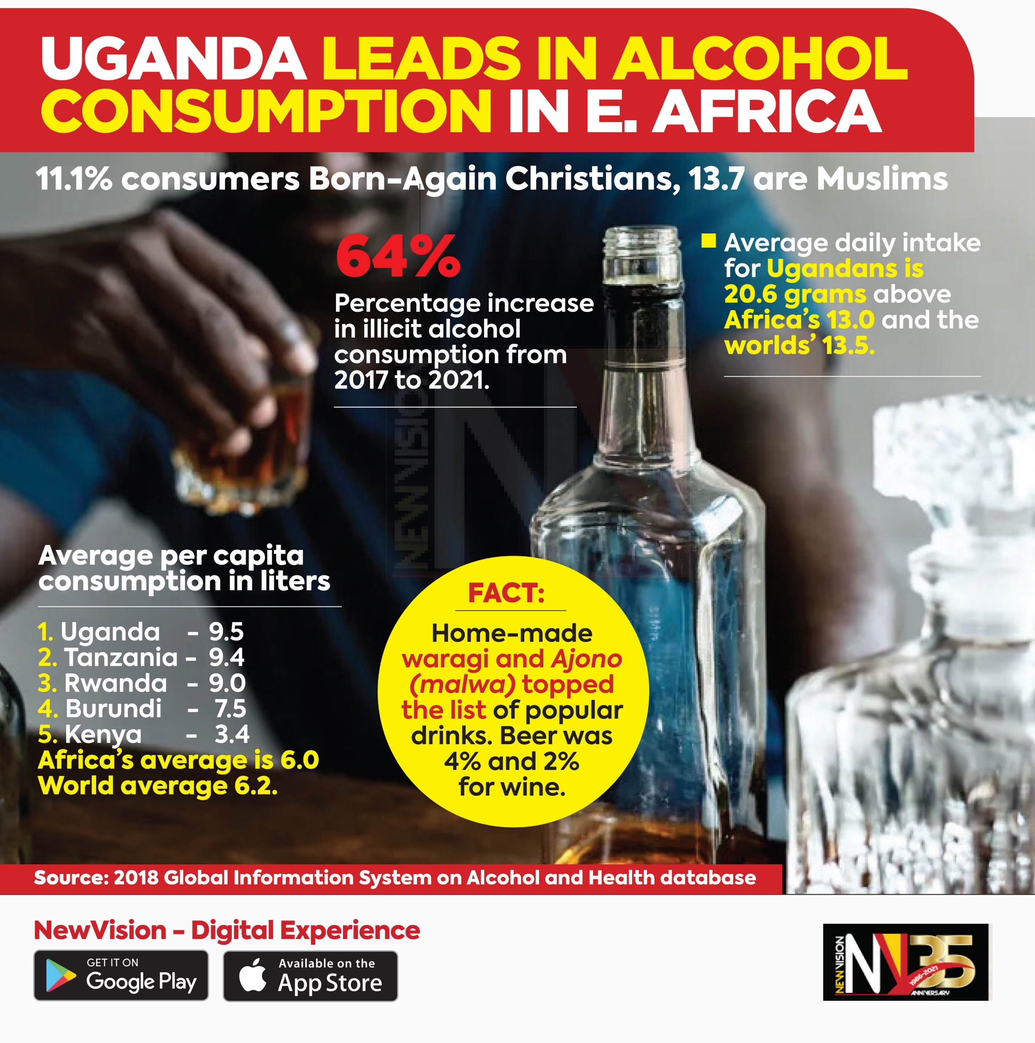
Key highlights
9.8% of have alcohol dependence problem (Kabwama et al 2016)
The dependence level is much higher in vulnerable populations for example its 19.4% among youth aged 15-24 in fishing communities (Kuteesa et al 2020)
52% in rehab centres are there because of alcohol addiction (Tumwesigye et al 2021)
31% alcohol use among 12-18 year olds (Swahn et al 2020)
Uganda Still leads in EA and among top 7 in Africa (WHO).

Slide 5
Ten key areas of intervention against harmful use of alcohol-WHO
Leadership, awareness and commitment.
Health services' response.
Community action.
Drink-driving policies and countermeasures.
Availability of alcohol.
Marketing of alcoholic beverages.
Pricing policies.
Reducing the negative consequences of drinking and alcohol intoxication.
Reducing the public health impact of illicit alcohol and informally produced alcohol.
Monitoring and surveillance.

Slide 6
Research gaps in the key intervention areas
Leadership, awareness and commitment
  We now have a policy in place and a team of NGOs, MPs and individuals advocating for change. There is UAPA coordinating all affiliated organisations. This calls for
    -implementation research
    -monitoring the levels of awareness and adherence to new rules and laws
Health services' response.
  awareness of the gravity of the problem among health workers
  possibility of integration of alcohol screening tools in patient assessment
  Will introduction of CAGE or AUDIT assessment tools increase self -awareness of alcohol problems and thus trigger reduction in consumption in other studies [1]

Slide 7
Research gaps cont’d
Community action.
  By laws have been used to prevent alcohol abuse in Uganda but little has been done to study their effectiveness. E.g- Example is the Gulu alcohol control ordinance of 2016 [2]. They even managed to convince the ministry of trade of the need for the ordinance [3].
  Home grown remedies akin to Iceland and Sri Lanka success stories

Slide 8
Gaps cont’d
Drink-driving policies and countermeasures
  Awareness of drink-driving policies? Do people know the limits- alcohol sellers and buyers?
  -What are Levels and patterns of drink driving
  What factors are associated with the drink driving?
  -mystery client at bars- do attendants still give alcohol

Slide 9
Gaps cont’d
Availability of alcohol
  This refers to both distance and cost. There are many studies that support reduced availability as a way to reduced alcohol abuse and its effects[4, 5]. One of the latest studies is in Estonia where alcohol related mortality reduced by 30-40% .
  Will changes in alcohol availability reduce alcohol consumption- current study on processes that led to ban of alcohol in 2019.
  How has the ban helped reduced alcohol abuse and its effects in Kenya, Ivory cost, Senegal, Malawi?
  What is the relationship between density of alcohol selling points and alcohol consumption?
  Mapping of alcohol selling points and negative outcomes like poverty,
  why should we allow people to drink from midday and not later?

Slide 10
Gaps cont’d
Marketing of alcoholic beverages.
  There is a lot of evidence connecting advertisement and alcohol consumption in Uganda[6, 7] Adolescent boys and young men who possessed items with an alcohol brand logo in Uganda had higher odds of consuming alcohol than those who did not[8].
  Adverts- can we restrict advertising? And how far can we go with this?
  How much of advertising reaches children and other vulnerable population?
  What are the best practices from other countries?
Pricing policies
  There is lack of research on impact of different pricing.
  Wont over pricing drown people into local, unregulated alcohol?
  Reducing demand through taxation and pricing mechanisms;

Slide 11
gaps
Reducing the negative consequences of drinking and alcohol intoxication.
  cost benefit analysis of existing rehab services ? Currently most of these are private and quite expensive.
  The feasibility analysis for setting up the rehab centres upcountry. Most are in Kampala
  Stigma- main reason people shy away from public facilities.
  accessible and affordable treatment for people with alcohol-use disorders
Monitoring and surveillance
  Can we manage a fully fledge monitoring and evaluation system? A pilot test in 2019/20 showed this is possible with 100% compliance of participating rehab centres.
  Can alcohol screening data be integrated into the HMIS?

Slide 12
Conclusion
The country ‘s level of alcohol use and negative outcomes still high
Plenty of work to get evidence that can drive policy formulation and implementation
Communities and everyone is a key player
Monitoring and evaluation cuts across several interventions

Slide 13
References
1. Clifford, P.R., S.A. Maisto, and C.M. Davis, Alcohol treatment research assessment exposure subject reactivity effects: Part I. Alcohol use and related consequences. Journal of studies on alcohol and drugs, 2007. 68(4): p. 519-528.
2. Laing, T., et al., Gulu-District_Towards-an-Alcohol-Ordinance_2015. 2015, Movendi International.
3. Nafula, A., Gulu district council goes ahead to implement the alcohol control ordinance, Capital radio, January 31, 2017. 2017, Capital Radio: Kampala.
4. Stoppel, R., Alcohol availability and alcohol-attributable mortality: economic implications following a change in sales policy. CESifo Economic Studies, 2021. 67(4): p. 463-483.
5. de Andrade, D., et al., The impact of changes to alcohol policy on patron drinking behaviours in Queensland. Drug and alcohol review, 2021. 40(5): p. 728-737.
6. Dunklin, S., Understanding Alcohol Marketing and Youth Alcohol Consumption in Kampala, Uganda. 2021.
7. H Swahn, M., et al., Social norms regarding alcohol use, perceptions of alcohol advertisement and intent to drink alcohol among youth in Uganda. International Journal of Health Promotion and Education, 2022: p. 1-17.
8. Kabwama, S.N., et al., Alcohol use and associated factors among adolescent boys and young men in Kampala, Uganda. Substance Abuse Treatment, Prevention, and Policy, 2021. 16(1): p. 1-9.
9. WHO. 10 areas governments could work with to reduce the harmful use of alcohol (who.int)
10. Kuteesa, M. O., Weiss, H. A., Cook, S., Seeley, J., Ssentongo, J. N., Kizindo, R., ... & Webb, E. L. (2020). Epidemiology of alcohol misuse and illicit drug use among young people aged 15–24 years in fishing communities in Uganda. International journal of environmental research and public health, 17(7), 2401.

